Slide 1
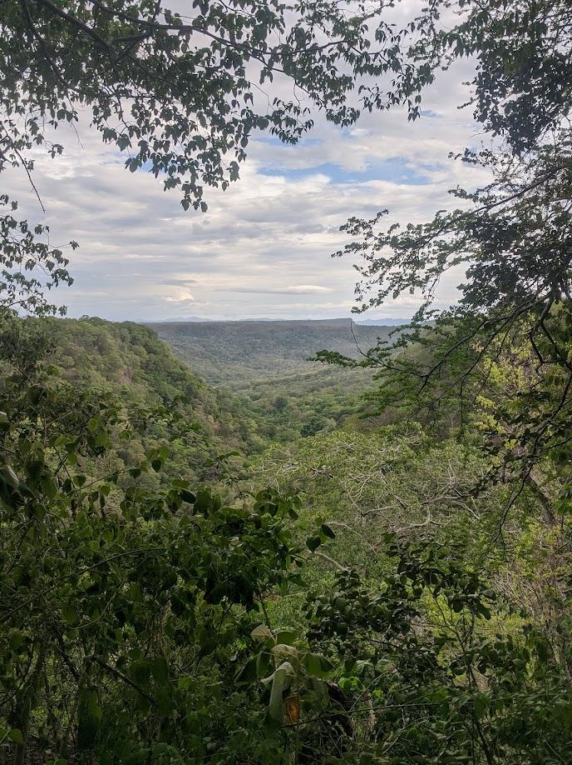
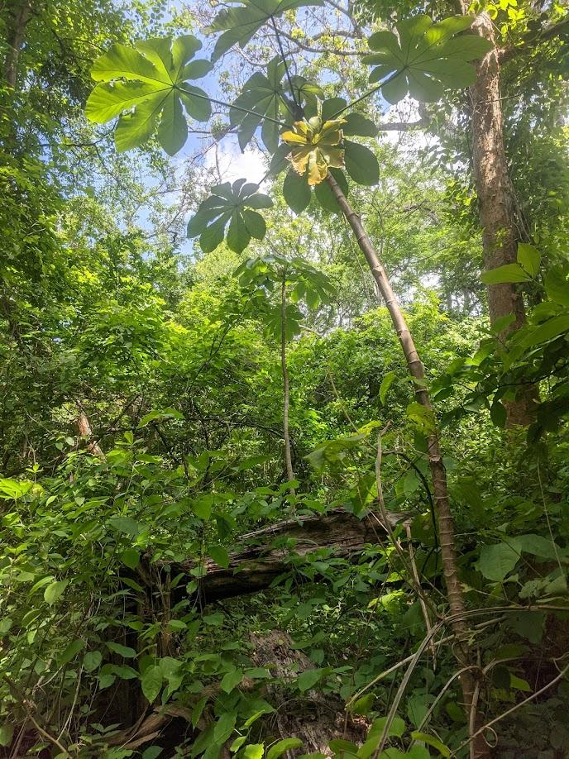

An Introduction to the San Emilio Forest Dynamics Plot: Assessing the drivers underlying four decades of change in a neotropical seasonally dry forest
Brian J. Enquist
University of Arizona

Slide 2
Acknowledgements
Nathan Swenson, Adam Chmurzynski, Nelson Zamora, Roberto Espinoza, Roger Blanco, Alejandro Masis, Steve P. Hubbell, George C. Stevens
Catherine Hulshof, Cho-ying Huang, Carolyn A. F. Enquist, Sandra Duran, Lisa Patrick Bentley, Arturo Sanchez-Azofeifa
Field Crews
Support
Funding and Institutional Support
Adrian Solis-Vargas
Gustavo Delgado
Qing He
Hsin-Ju Li
Damani Eubanks
Matiss Castorena
Maria-Fernanda
Obando-Picado
Milagro Jimenez
Josue Pacheco
Dan Janzen
Winnie Hallwachs
Maria Chavaria
Jon Sullivan
Camillo Camargo
Lisa Rose
Tom Gillispie
R. Franco
J. Klemens
National Science Foundation
Fulbright Fellowship(s)
Nature Conservancy
Tinker Foundation
National Geographic
ForestGEO
ACG, Costa Rica
Instituto Nacional de Biodiversidad (INBIO)
National Herbarium of Costa Rica

Slide 3
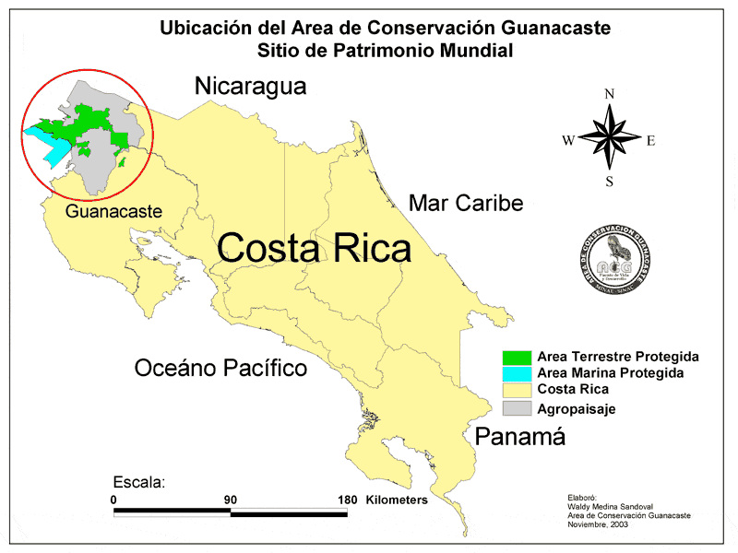

Area de Conservación Guanacaste is a network of protected areas and a World Heritage Site in Guanacaste Province, in northwestern Costa Rica

Slide 4

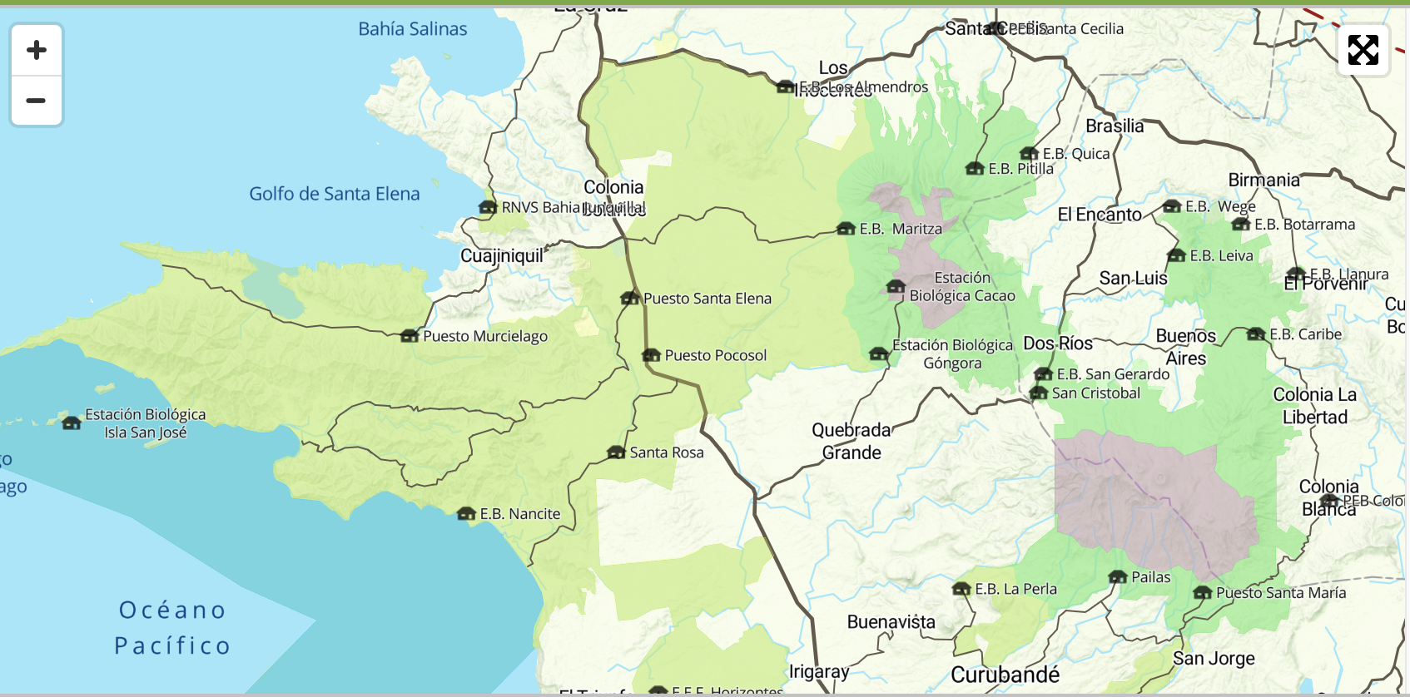
Rain Forest
Dry Forest
Cloud Forest

Slide 5
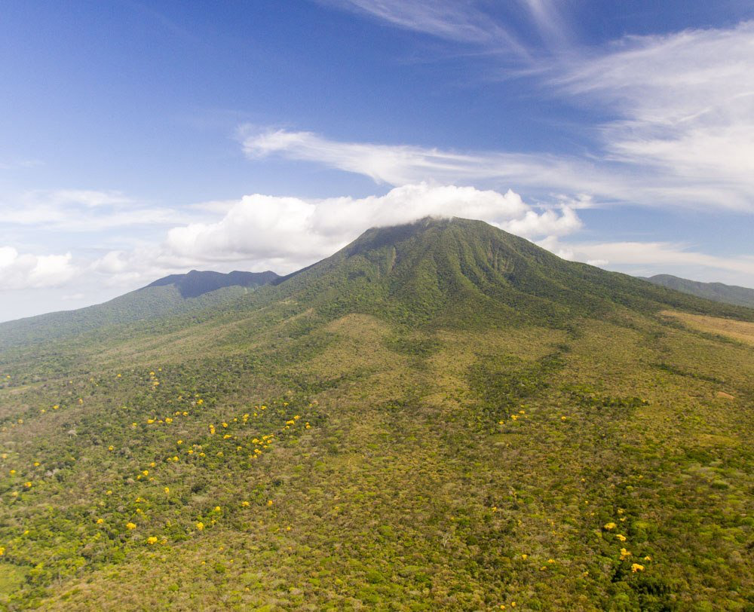
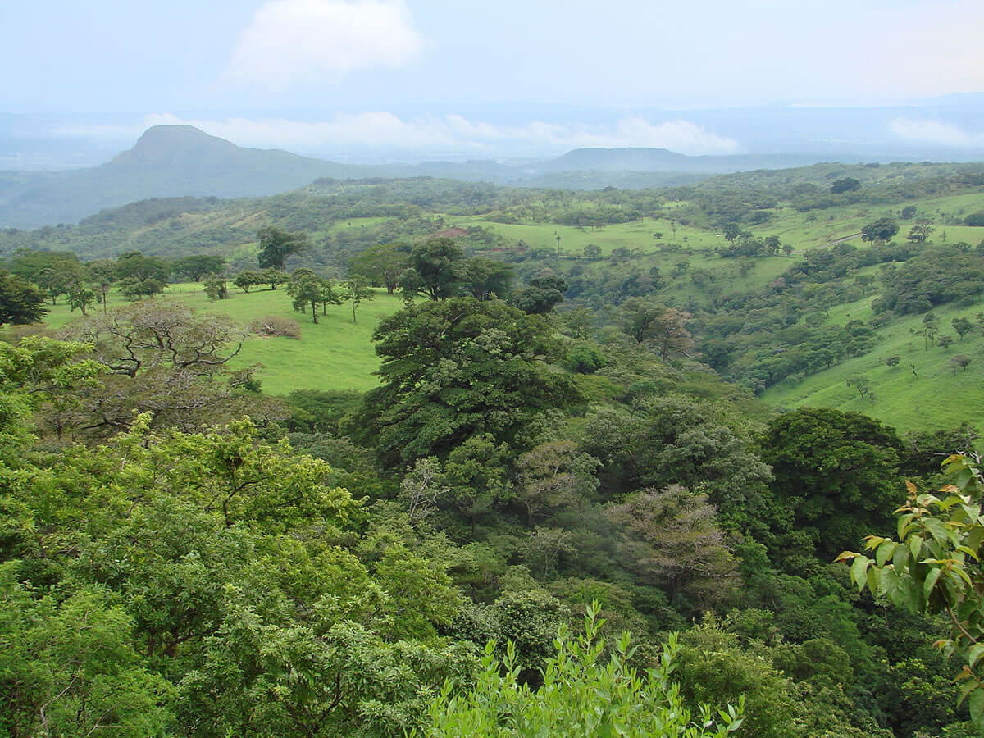
Rain Forest
Dry Forest

Slide 6
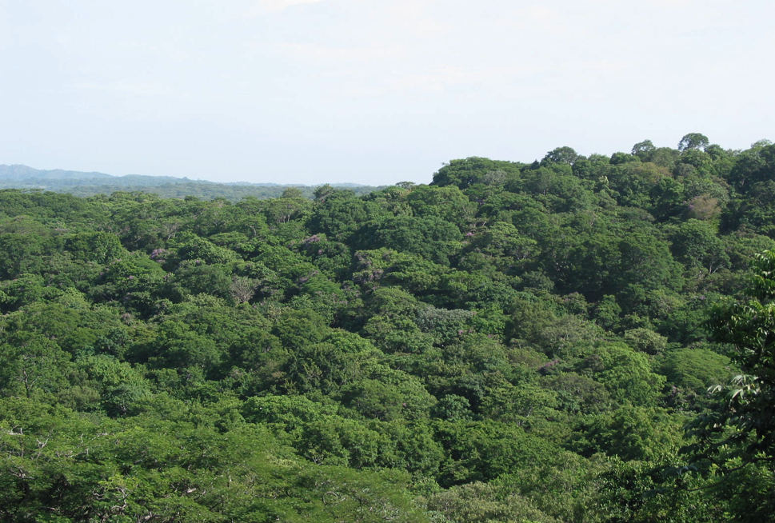
San Emilio Forest Dynamics Plot
~16 ha plot: 680m x 240m rectangle
Plot initiated in 1976 by S.P. Hubbell and G.C. Stevens
All trees and lianas 3cm dbh measured and spatial position mapped
~150 tree species in the plot
Forest surveys completed in 1976, 1996, 2006, 2020

Slide 7
Why is this forest plot notable?
Tropical dry forest (seasonal drought, high interannual variation in rainfall)
A bellwether for the fate of more mesic tropical forests under climate change
One of a relatively small number of dry forest plots
Disturbed
It is in various stages of recovery from human disturbance
An accurate reflection of an increasing large fraction of tropical forest
Long-term dynamics
Although only 1 census with ForestGeo protocol, 3 additional surveys with overlapping protocols provide 44 years of forest dynamics.

Slide 8
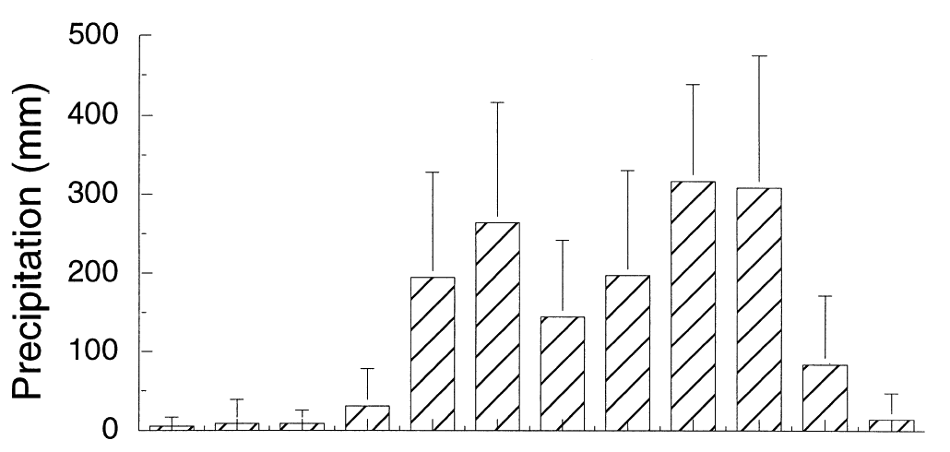
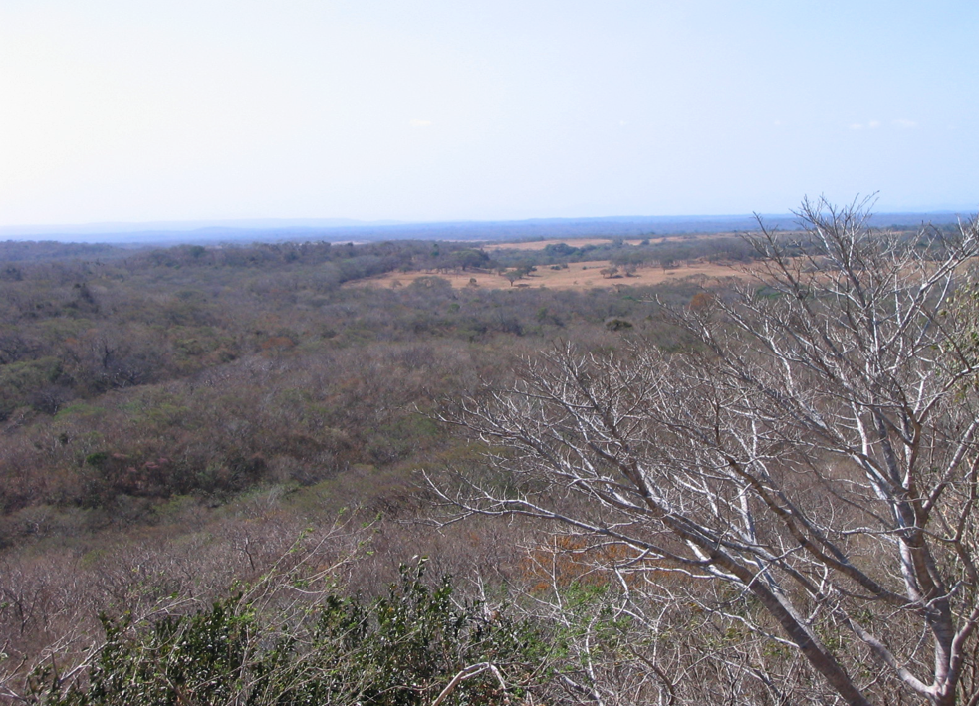

Annual Precipitation Lowland Guanacaste
Distinct dry season ~ 5-6 months of little to no rain
Mean annual rainfall 1565 ± 463 mm (mean ± SD)
Annual rainfall highly variable – ranging from 3,000mm (1937) to 700mm (1985)

Slide 9


Initial Forest Survey 1976 and 1977
George C. Stevens
Stephen Hubbell
Graduate student at the time
PI University of Michigan

Slide 10





The plot history is also a history of data technology

Slide 11
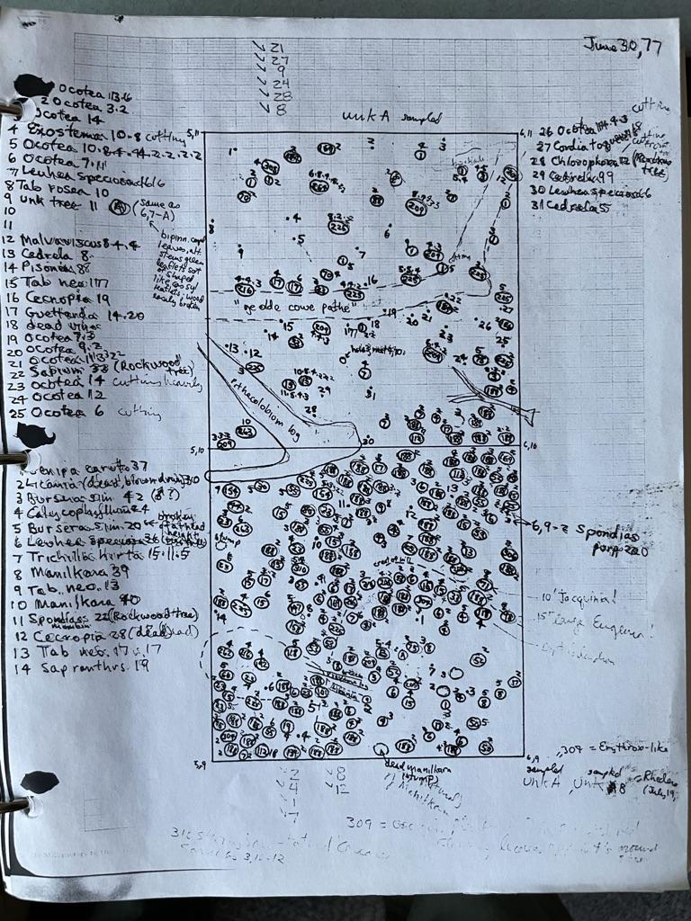
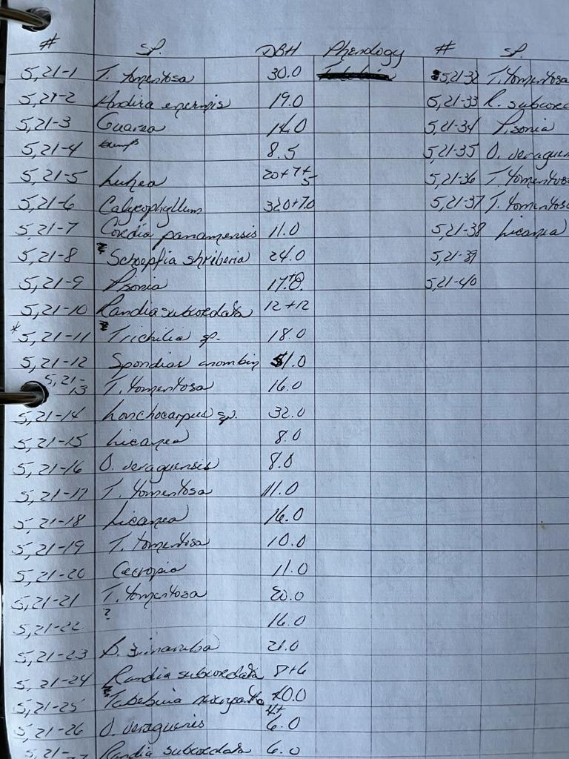
Entire San Emilio plot was gridded using metal stakes at 20m intervals.
Each 20x20m subplot were mapped by hand using graph paper. Data recorded on sheets

Slide 12
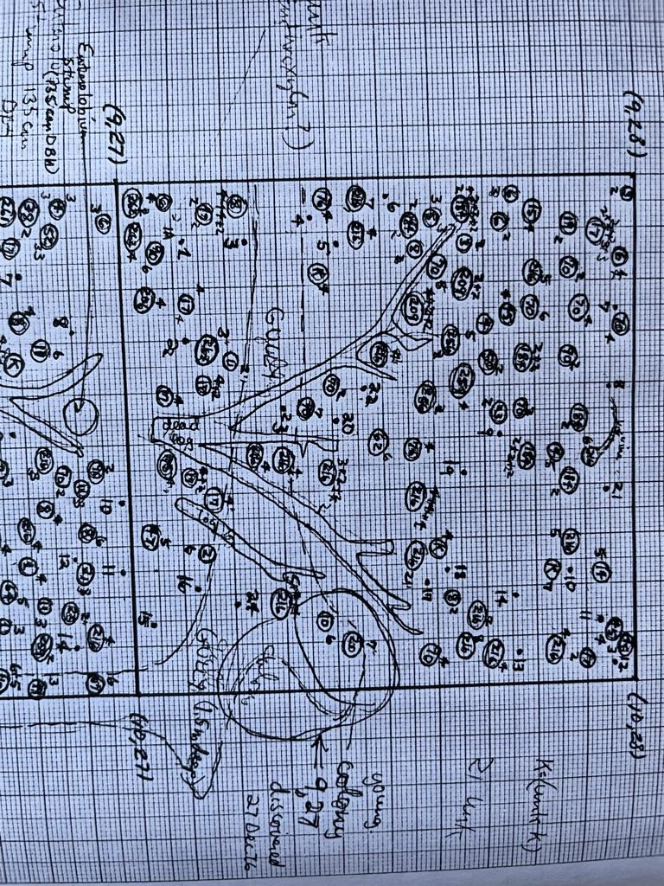
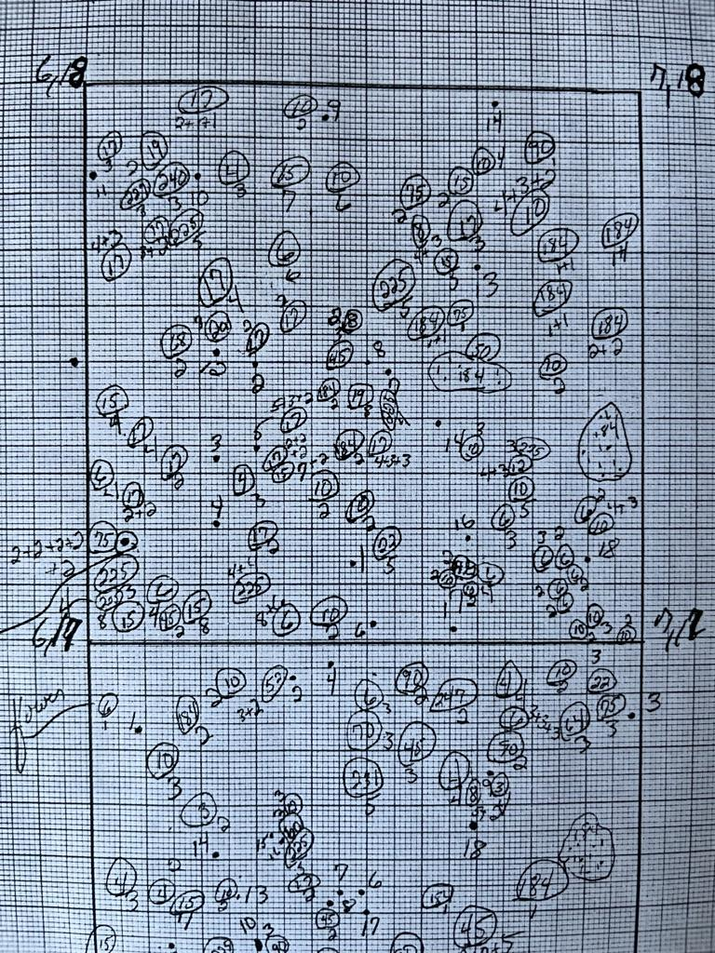
Species number recorded in each stem location. DBH recorded just outside stem location. Other information for each plot (ant colonies, fallen trees, topography) were also recorded in 1976

Slide 13
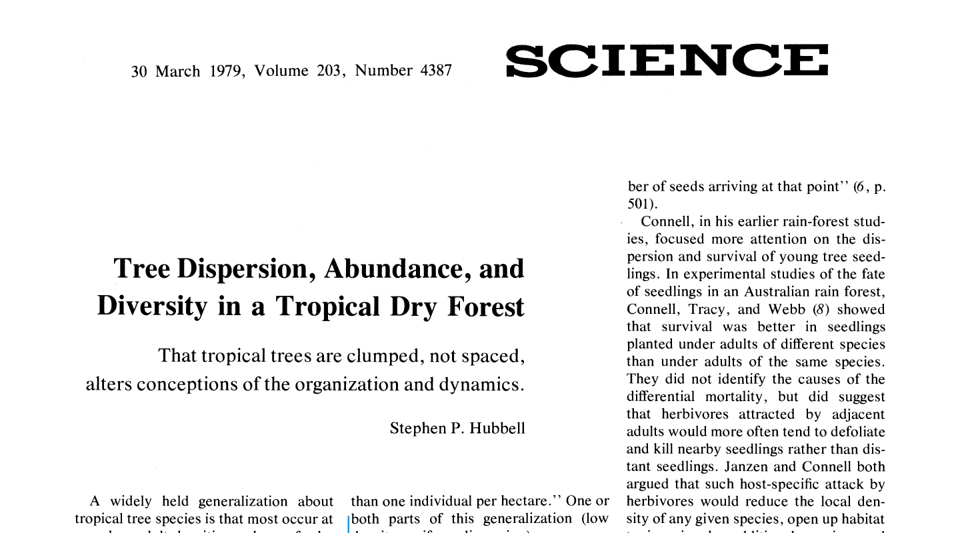
Is this the plot where Hubbell collected data for his 1979 paper?
No
But that work was in a similar tropical dry forest about 40km south
It was cut and is now cattle pasture

Slide 14
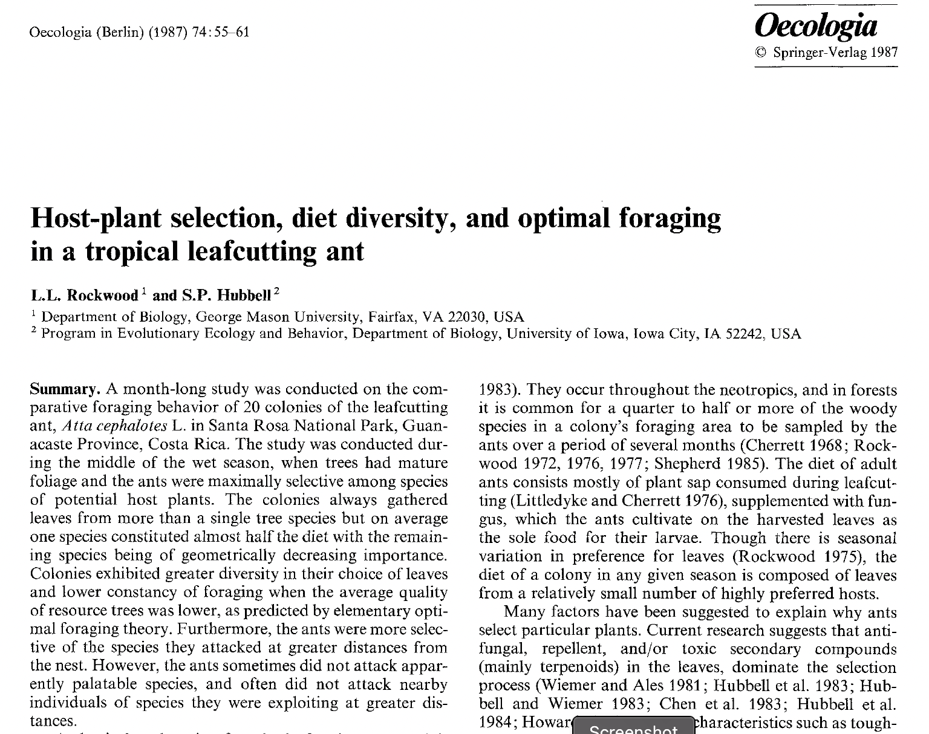
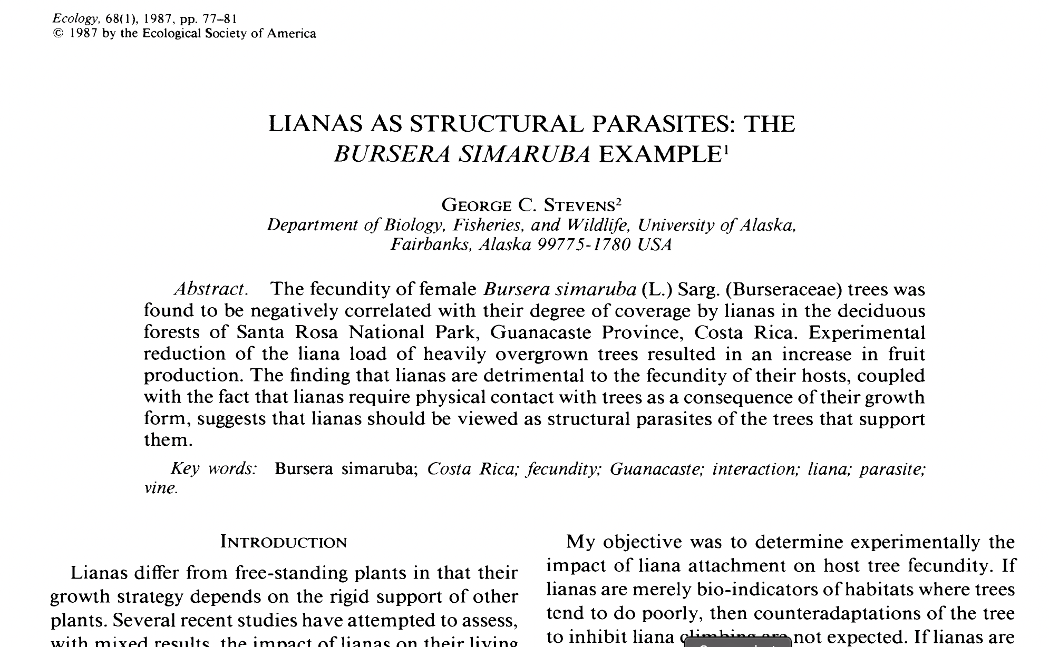
Earliest San Emilio publications

Slide 15

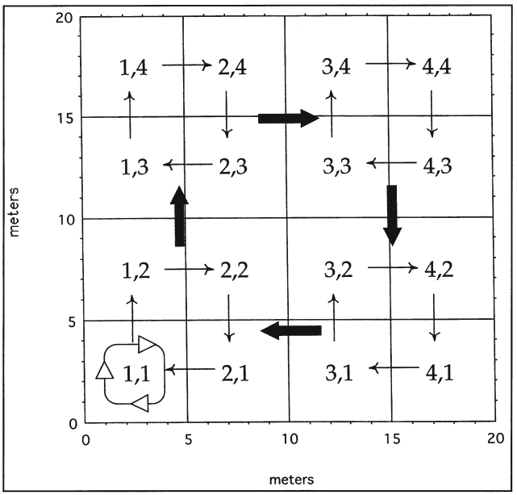

Post 1976 Protocol
20m
Plots are divided into four triangles
using tapes pulled between corners.
Sample W -> N -> E -> S
Start here End here
N
W
E
20m
S
Nathan Swenson
(2006)
Adam Chmurzynski
(2020)

Slide 16
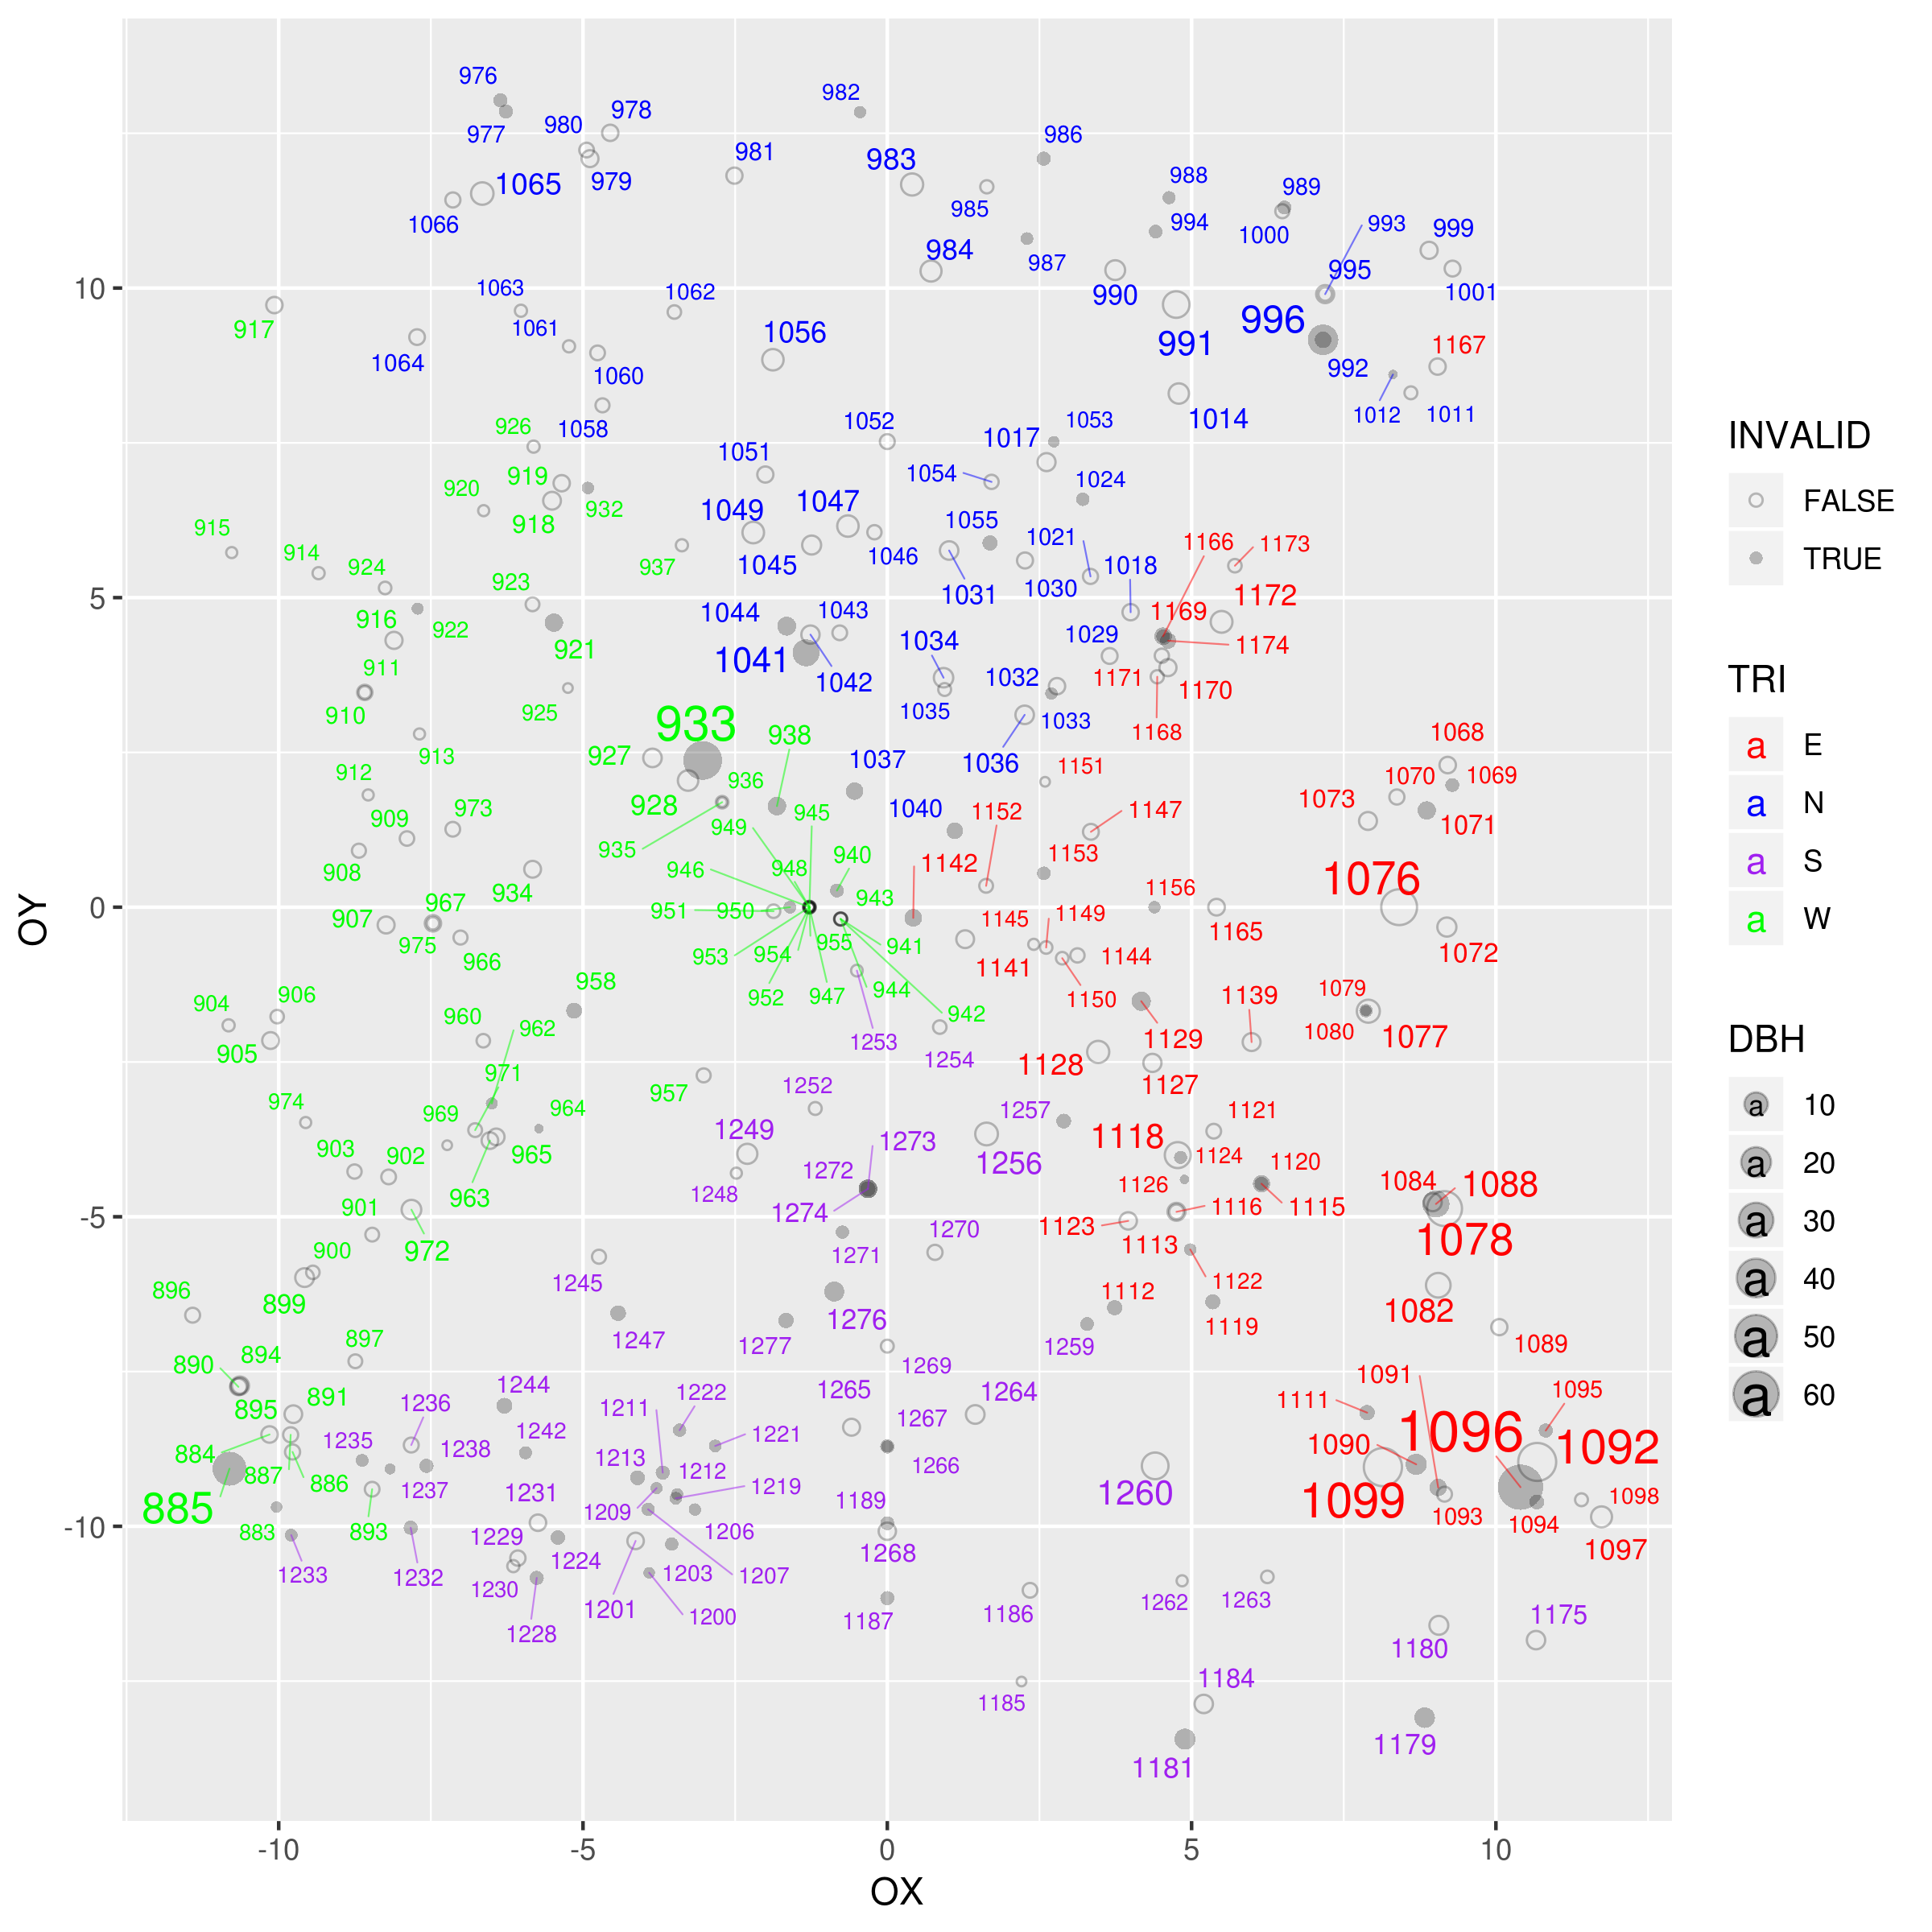
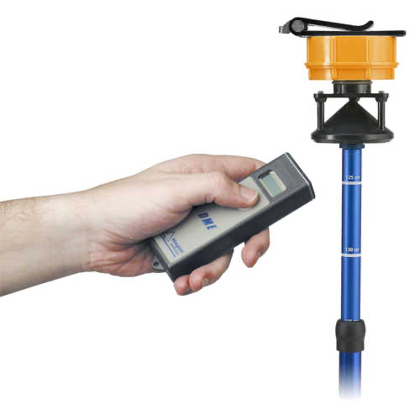
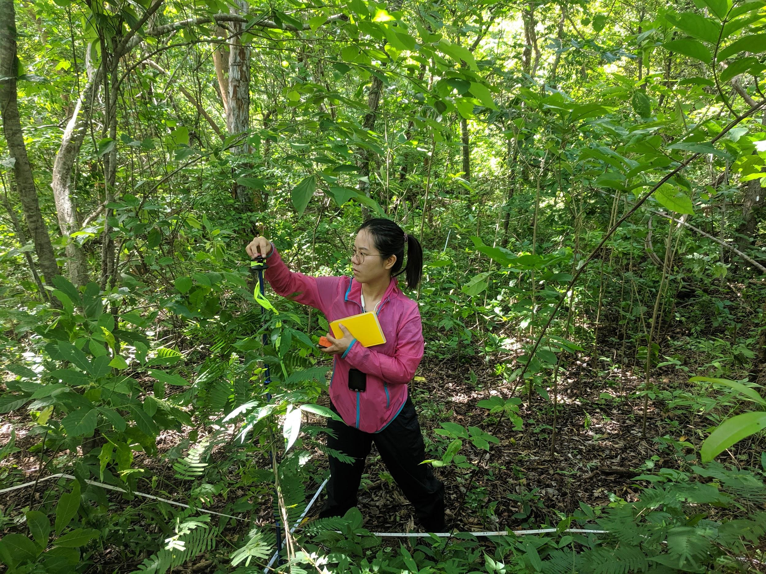
2020 Survey
Protocol
Stem distance and angle to center of plot
X, Y coordinate calculated
Haglöf DME 201
20m

Slide 17
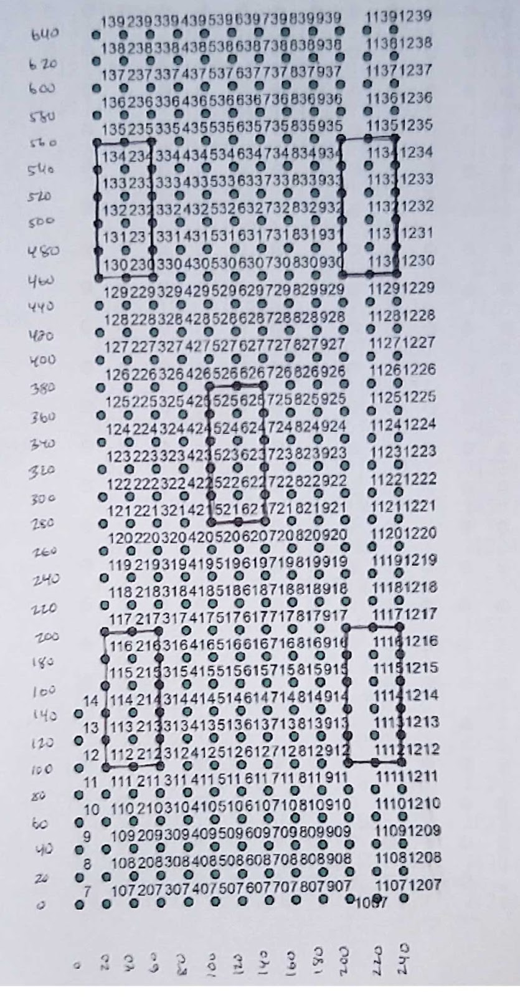
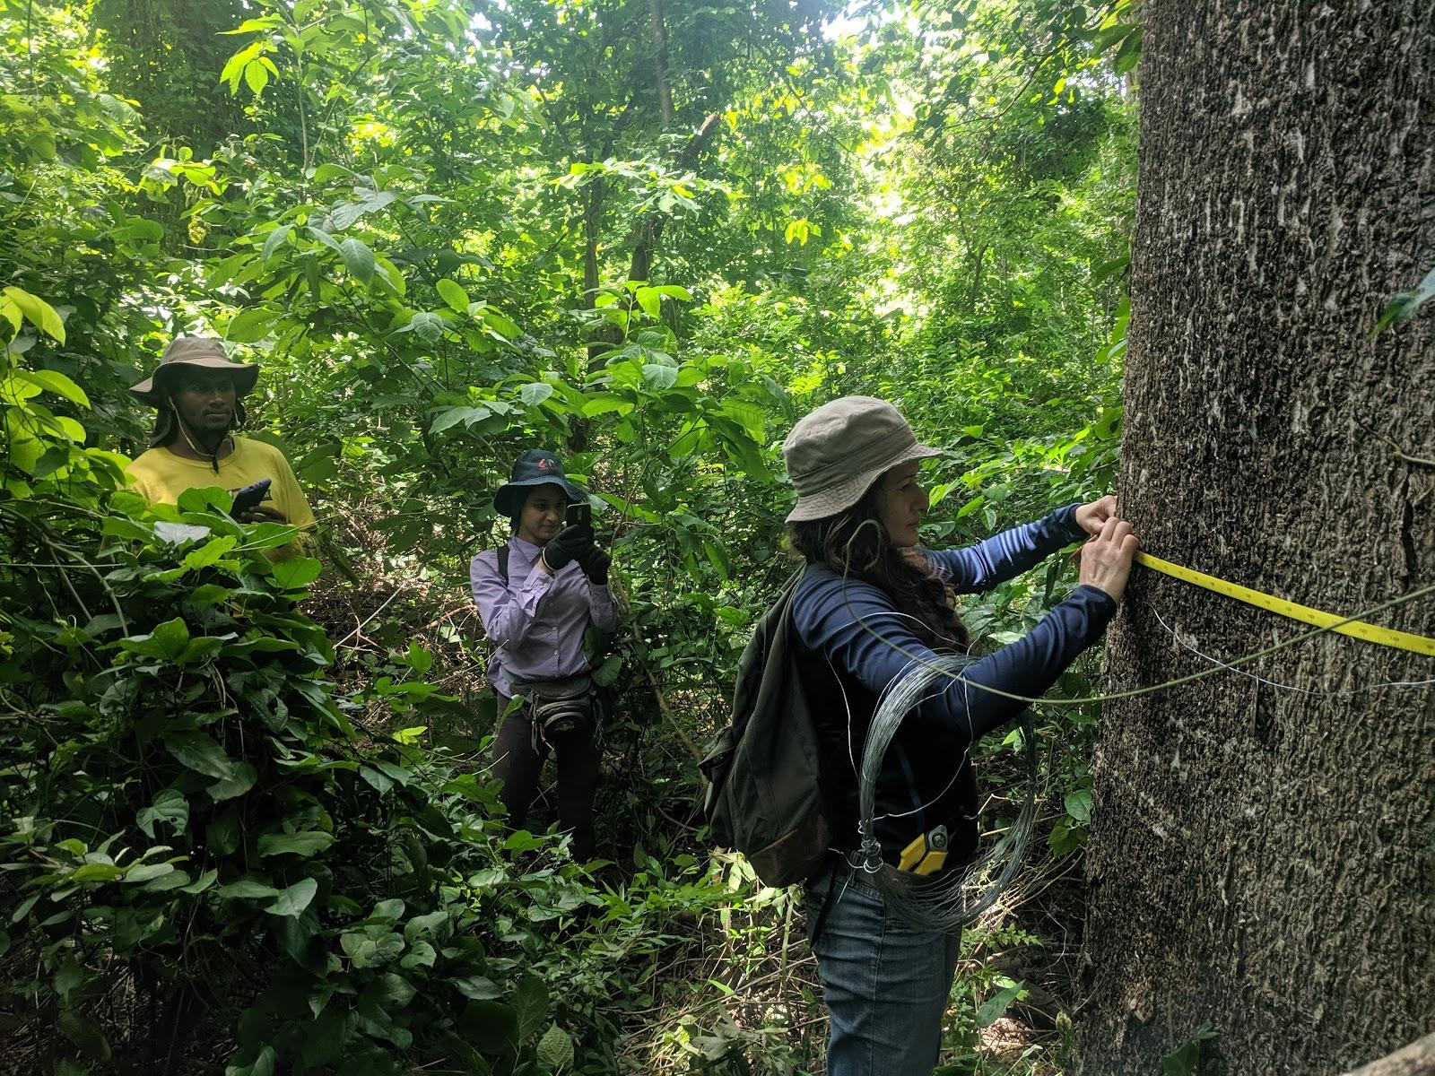
15 hectare plot - 388 20x20m quadrats
Plot was surveyed and marked with rebar in 1976 to form a 20m grid
All stems ≥ 1cm D.B.H 2020 (prior censuses >= 3cm D.B.H.)

Slide 18
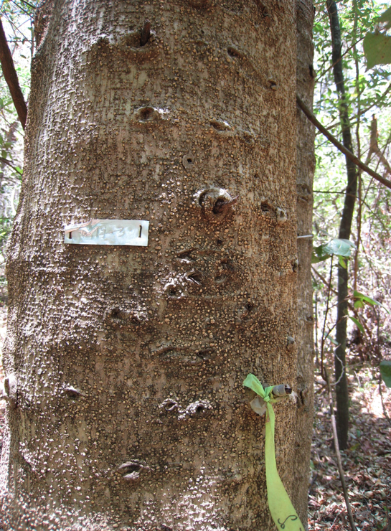
Many, but not all trees were tagged in 1976. Most were over 10cm dbh in 1976
April, 2008
MORACEAE - Maclura tinctoria

Slide 19
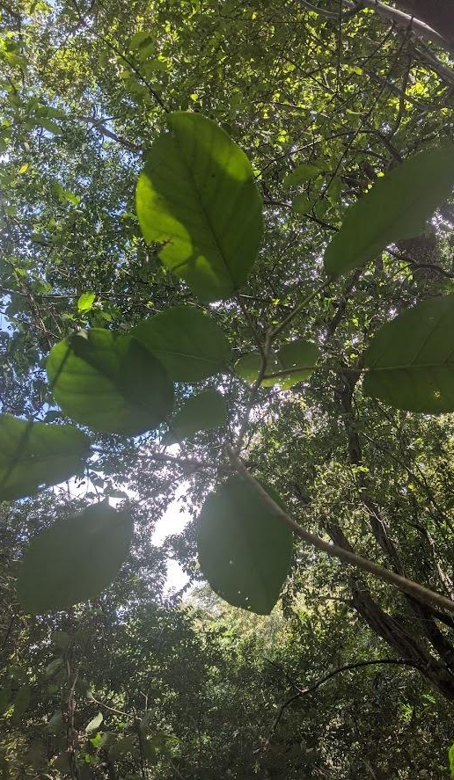
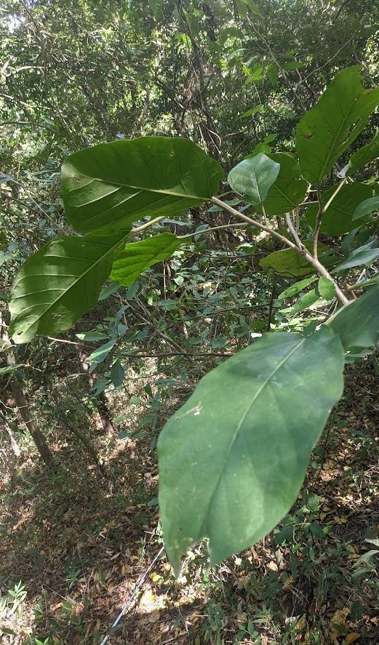
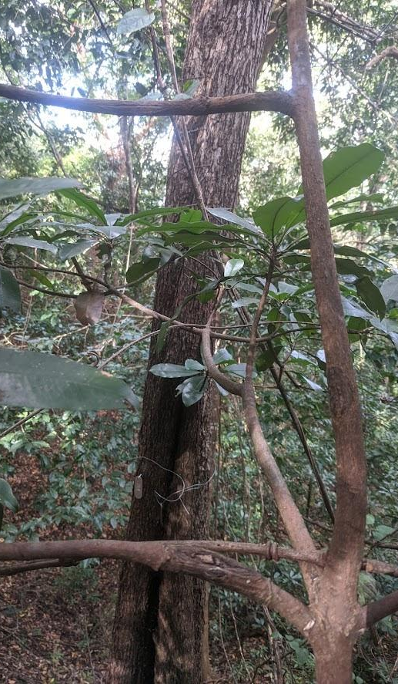

Slide 20
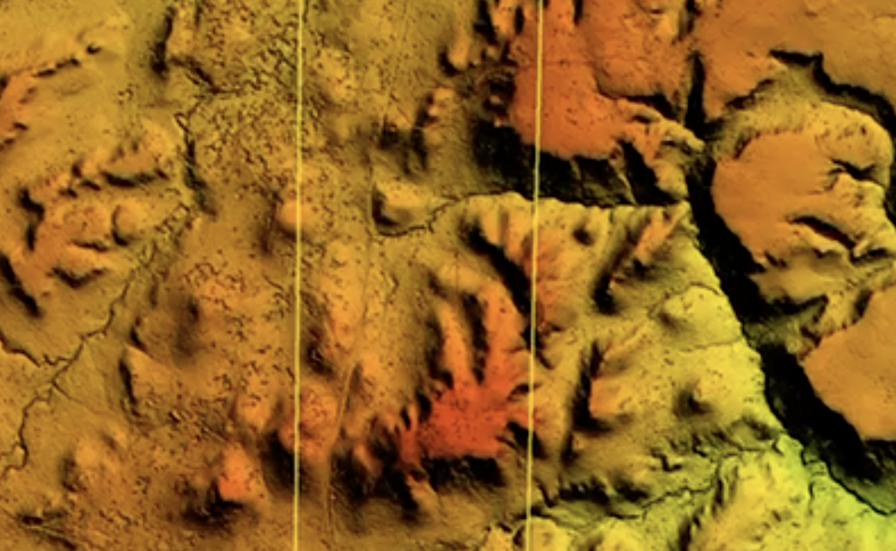
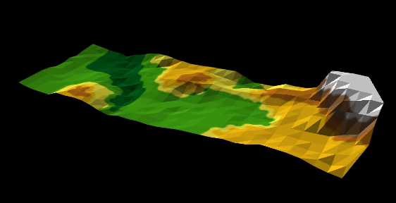
Elevational range: 308-354 m
Plot size: 680 m x 240 m
Lidar Elevation scan, 2021, Arturo Sanchez
Notes:
GIS generated plot of the distribution of habitat types and in the San Emilio forest site. ES=ephemeral stream, VB=valley bottom, SLP1&2=differential slopes, HT/R=hilltop/ridge, SS=steep slope, MT=mesa top. Elevational range: 308-354 m. Plot size: 680m x 240m.

Slide 21
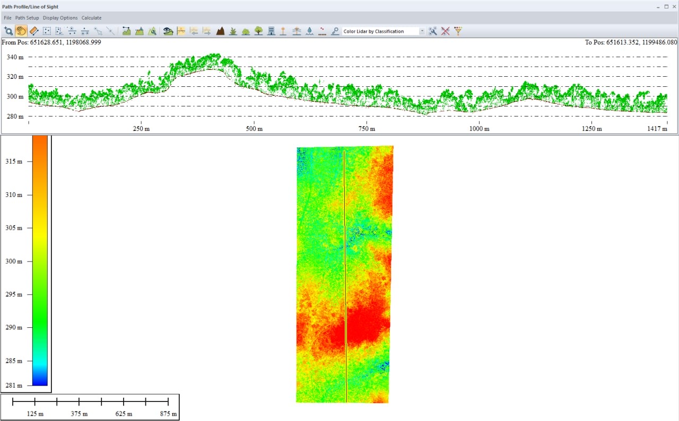
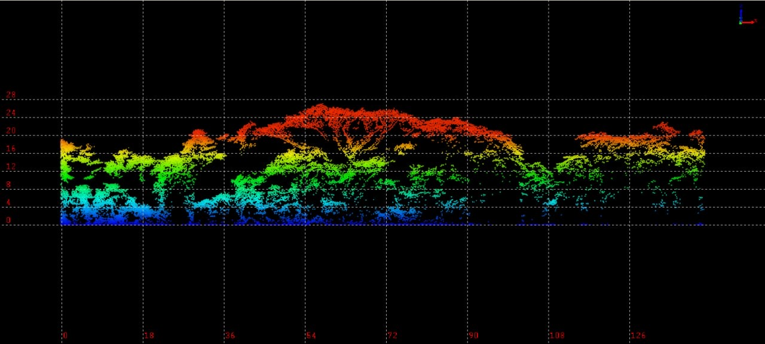
Lidar transect through the San Emilio Plot
Lidar Elevation scan, 2021, Arturo Sanchez

Slide 22
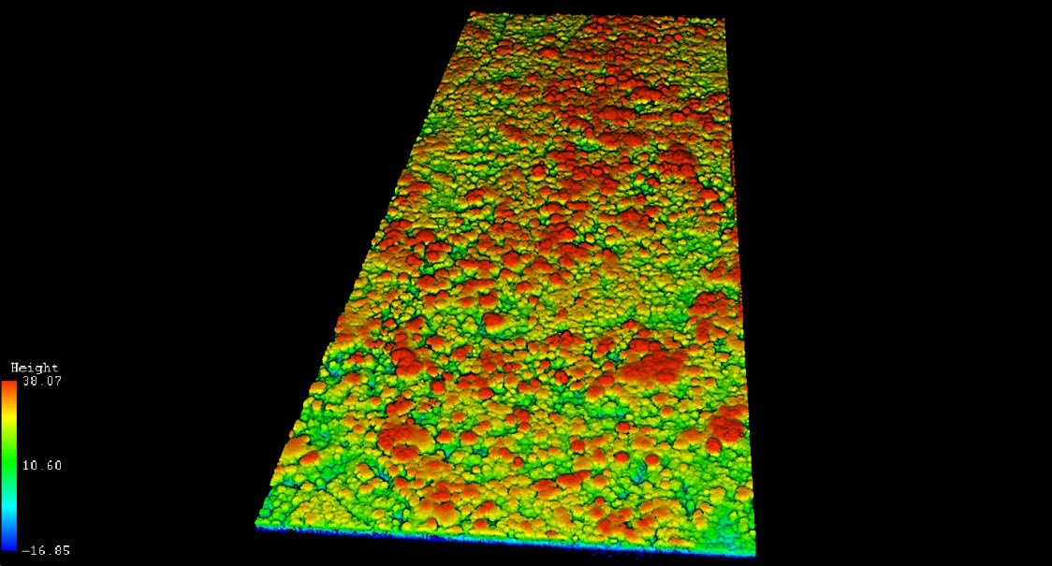
Lidar Elevation scan, 2021, Arturo Sanchez
Canopy heights

Slide 23
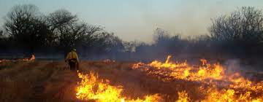
Plot History –
Disturbance
The entire plot has experienced some sort of disturbance
Spanish likely extracted large Mahogany trees within the plot
1910s – 1920 Dan Janzen 11/17/2021…. “ [The plot] it was a banana plantation for the Casona occupants in 1920 (we do not know when abandoned but sometime after that date). I learned that from Roberto Espinoza’s father, don Lupo Espinoza when I arrived in 1975 and was mystified by the pig ditches forming that enormous rectangle with the old ox-cart road along it northern boundary. Pig ditches were supposedly deep enough so that they served as fences to keep the domestic pigs (and peccaries?) out of the plantation. All of those large Enterolobium trees were planted by horses and cows after 1920 in the very open part of the plantation.”
Evidence that fires from nearby pastures entered plot as late as the 1970s?

Slide 24
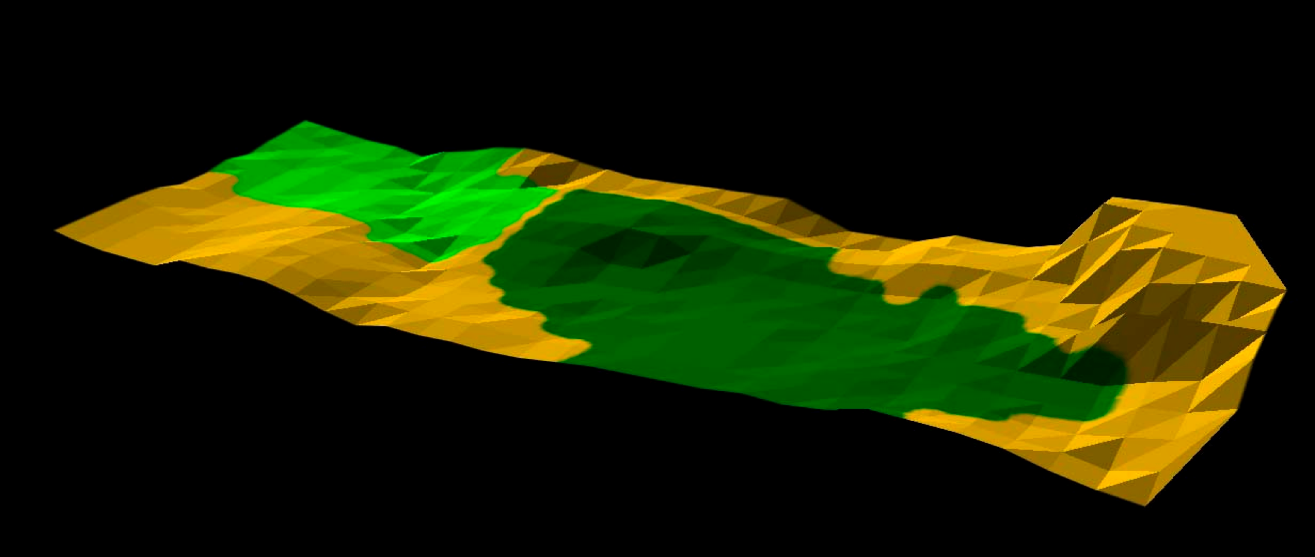
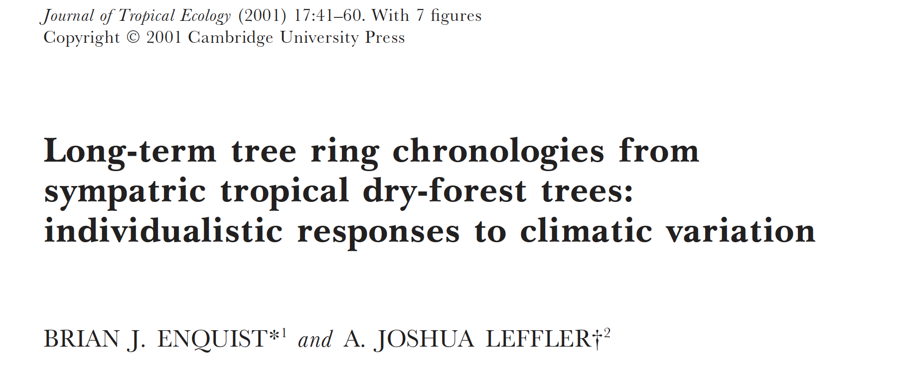
Mapping areas of different ages
1910's
More deciduous
Young
Using mapped fencerow trees
Old barbed wire
Tree rings
Mid-Age
Mid-Age
Oldest
1840’s ?
More evergreen

Slide 25
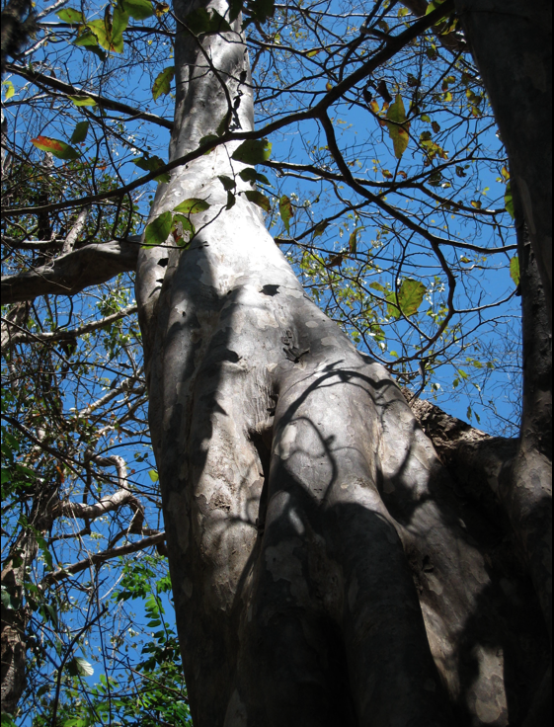
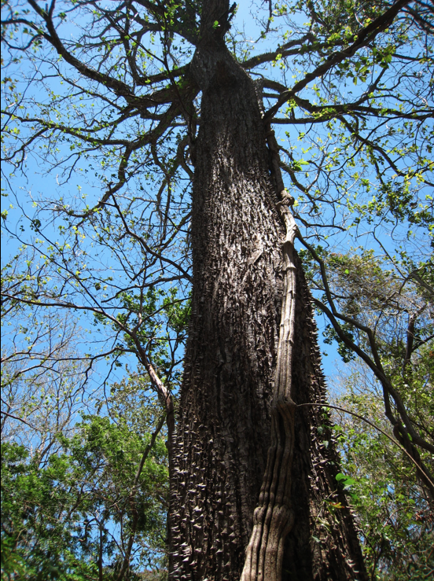
Guettarda macrosperma (RUBIACEAE)
Pachira quinata (MALVACEAE)
April 2008

Slide 26
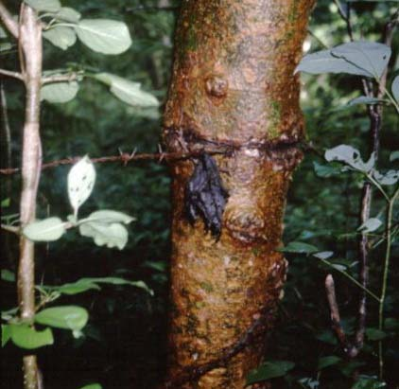
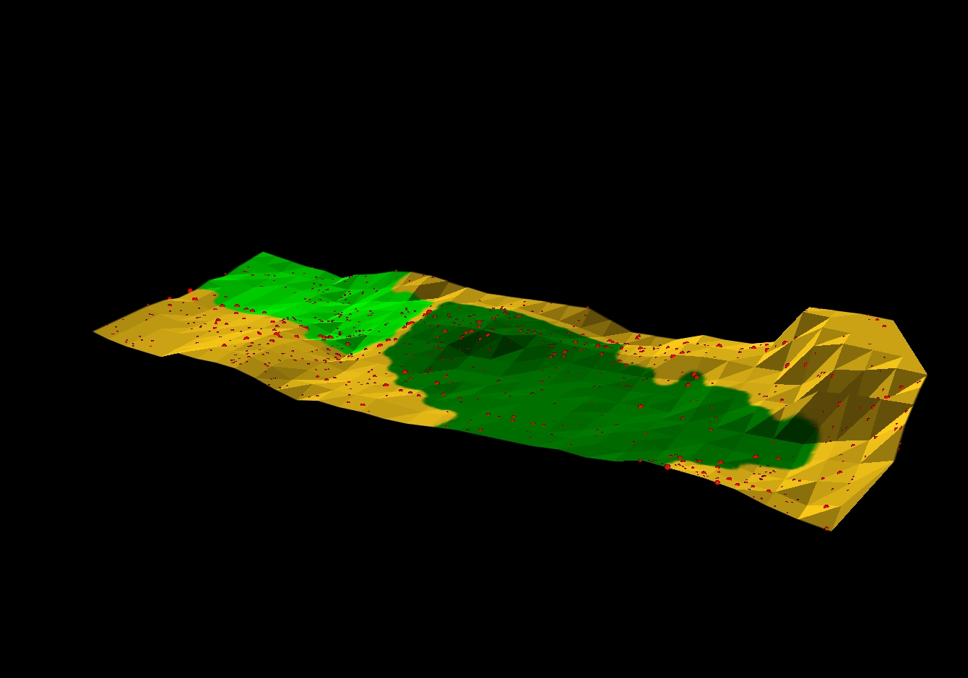
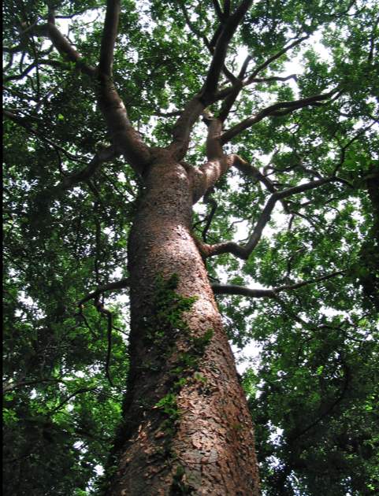
Young and old areas of forest
demarcated by old fence row
Trees and remnants of old dirt
roads/ditches and fences
Spatial distribution of Bursera simarouba in 1976
Note, locations of fencerow trees
Young areas consist of species common of young forest (Enterolobium, Cecropia, Samanea (Pithecelobium), Choclospermum etc.)

Slide 27
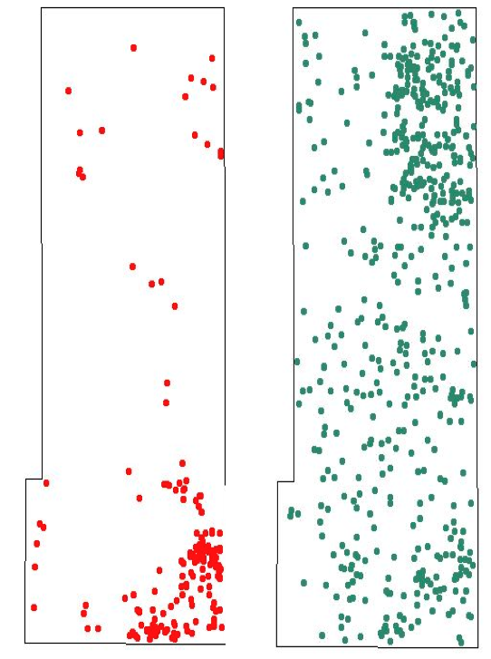
Species distributions in 1996
Rhedera trinerva
Luehea speciosa
more abundant on dry hill tops
more abundant in early
successional habitats
Notes:
The geographic distribution of two species (Rhedera trinerva (red) more abundant on dry hill tops and Luehea speciosa (green), more abundant in early successional habitats are also shown.

Slide 28
Two potential ‘drivers’ of forest dynamics
(1) Forest is heterogeneous in age (younger and older areas)
- Recovery from past disturbance
agriculture, pasture
SEFDP contains at least three areas of different ages
- Succession changes
(2) External drying trend, and increased number of drought years.
Climate change has increased the frequency of drought years
Increase in temperatures and Vapor Pressure Deficits (VPD)

Slide 29
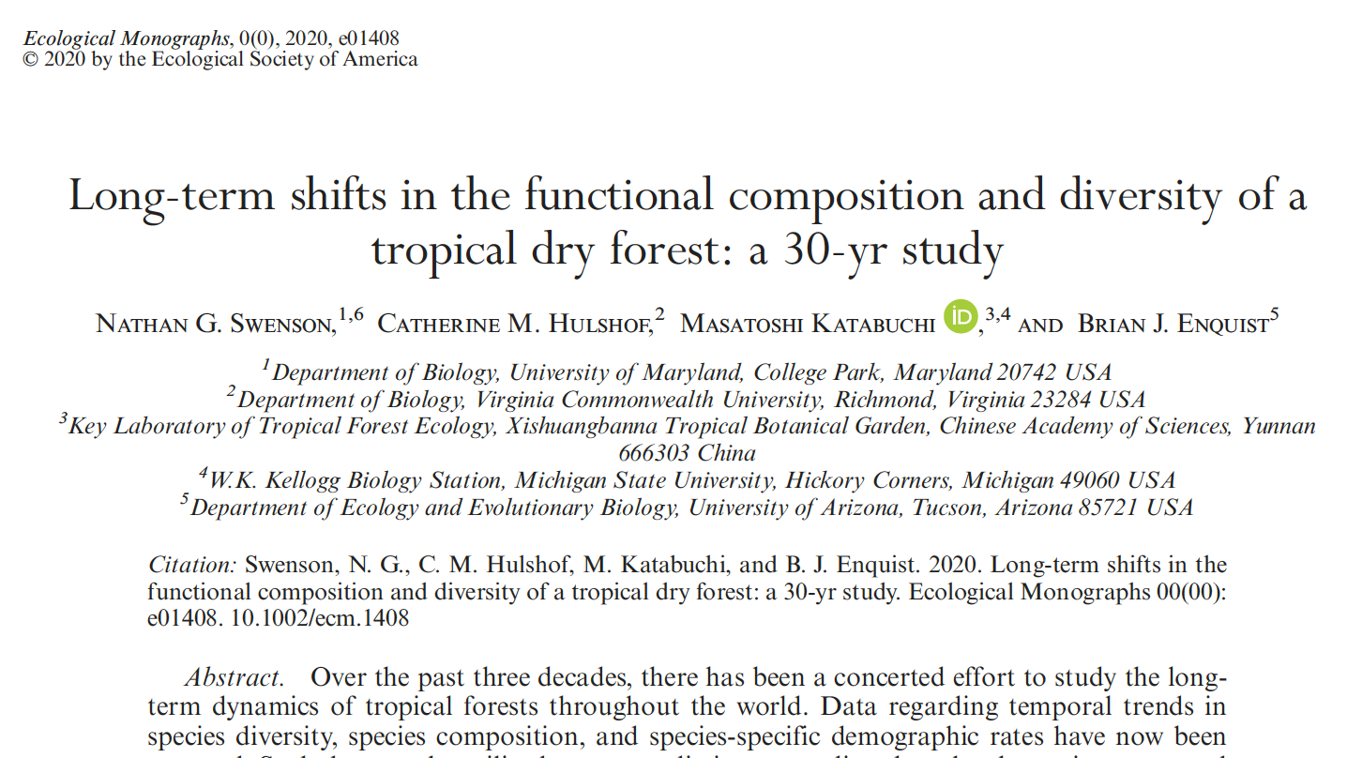
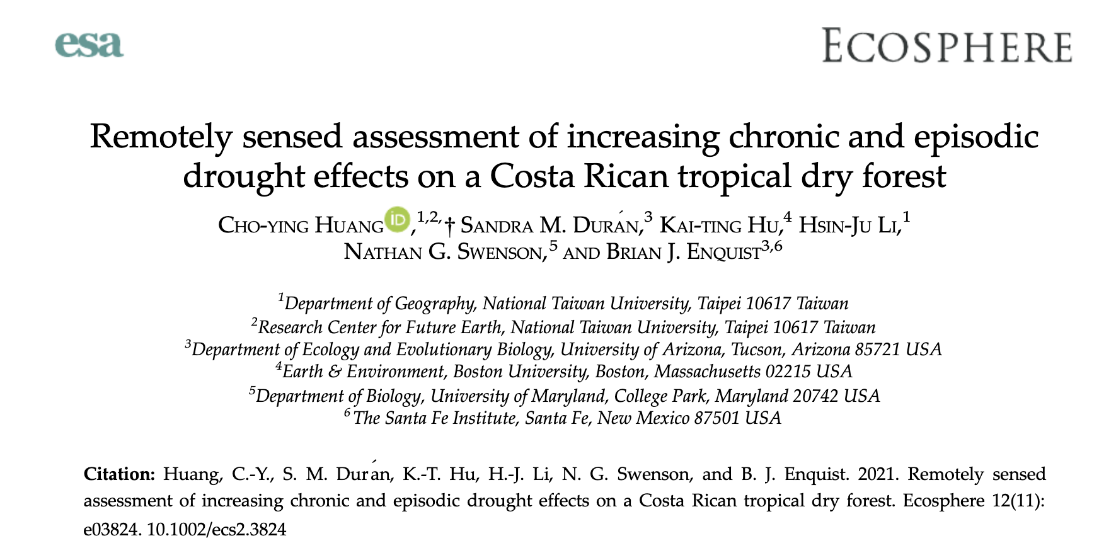
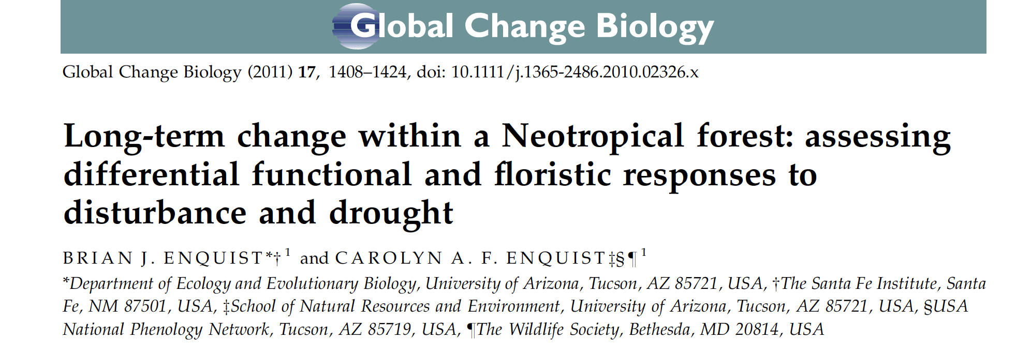

Slide 30
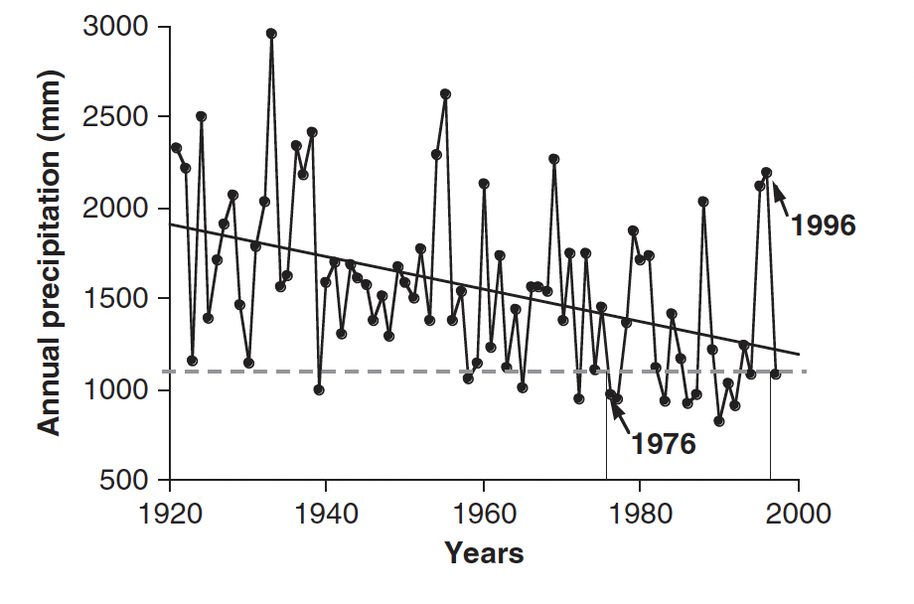
Changes in rainfall in lowland Guanacaste (1980-2018)
Many trees in youngest part of forest established
r² = 0.180, p = 0.0001
Decrease in mean annual precipitation
Increase in drought years.
In the 20 years between the first two census periods (1976 and 1996) there have been nine drought years where annual precipitation fell below 1 SD of annual rainfall (1 SD or 1100 mm annual rainfall; dotted line).
4 /55
7%
9 /22
41%
Data from the Las Pomas weather station, near Cañas, Guanacaste ~50km away (Borchert, 1998; W. Hagnauer & R. Borchert, unpublished results).
Enquist and Enquist (2011) Global Change Biology

Slide 31
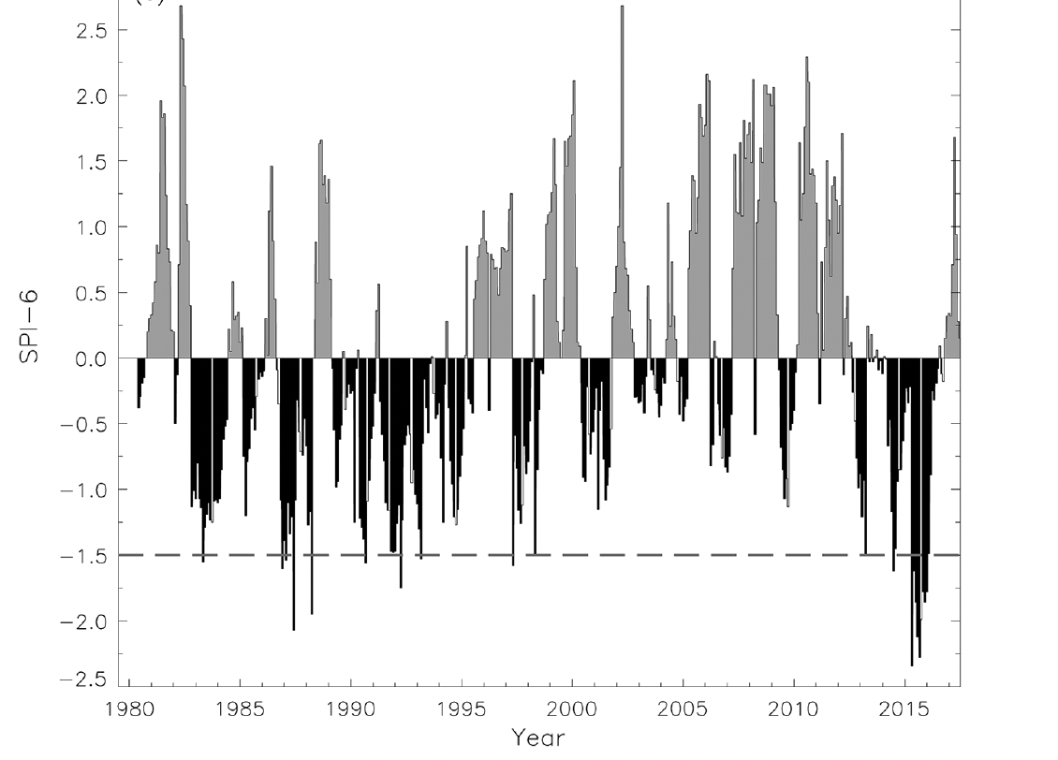
Changes in rainfall in lowland Guanacaste (1980-2018)
1996
2006
2020
After 1976 survey San Emilio has experienced increased drought conditions
Between 1996 and 2006 survey there was a wetter return to close to pre 1976 baseline
Since 2006 increased drought frequency with notable large ENSO 2015 drought
Second survey
Third survey
Fourth survey
Wet
Standardized Precipitation Index
Fraction of years in extreme drought prior to first survey
Dry
1921-1976
4 /55
7%
1 /10
3/14
Drought
9 /22
41%
10%
21%
Huang et al. (2021) Ecosphere

Slide 32
(1) Not much net change in absolute species richness but forest is shifting non-randomly
Species Richness:
1976: 159 2006: 126
1996: 150 2020: 145

Slide 33
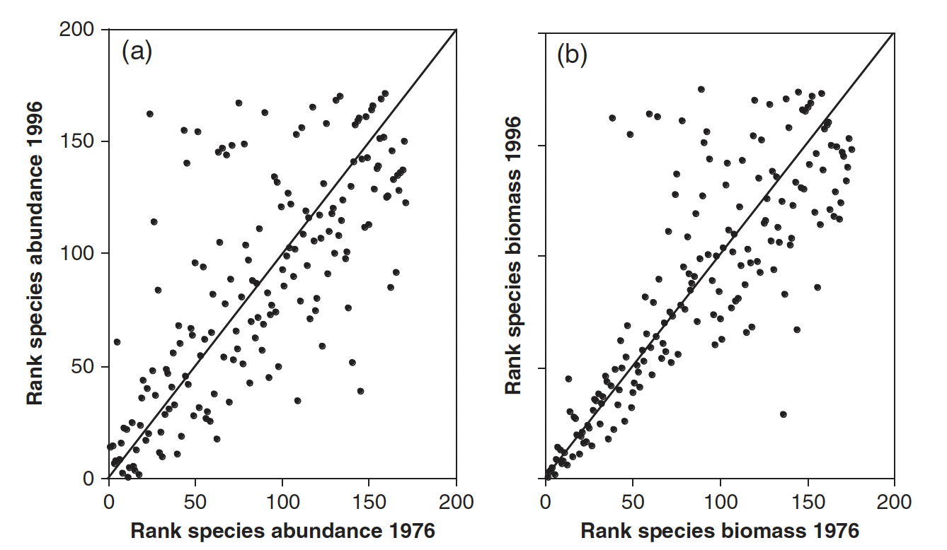
Enquist and Enquist (2011) Global Change Biology

Slide 34
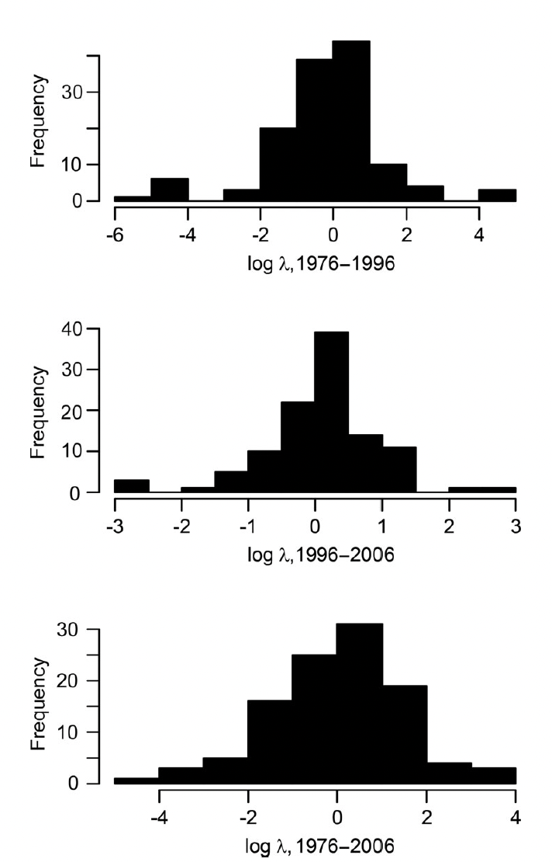
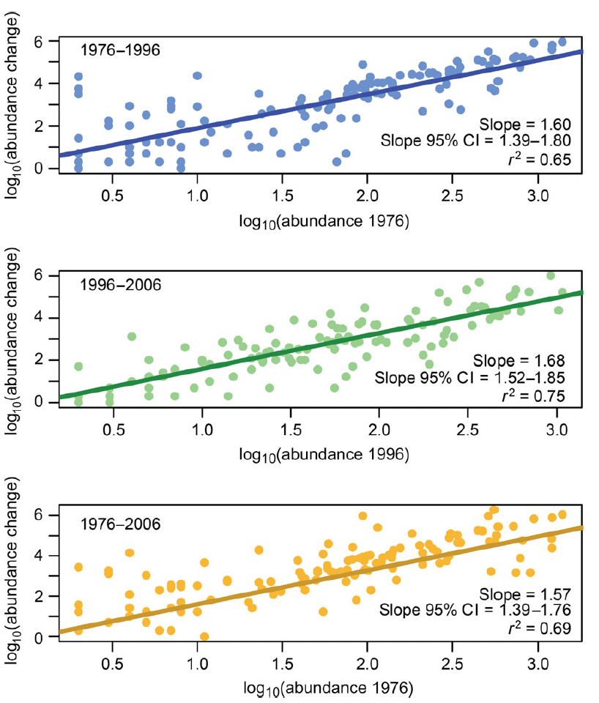
Based on theory in Chisholm et al. 2014 Ecology Letters
Slopes are greater than 1.0
Reject a model of pure demographic stochasticity driving the dynamics of this forest
Fail to reject a model of pure environmental stochasticity when excluding rare species but reject it when using all species.
Dynamics likely driven primarily by environmental drivers with some stochastic dynamics, most likely for rare species.
Swenson et al. (2020) Ecological Monographs
slopes did not
include the expectation for pure demographic stochasticity
(i.e., a slope of 1) or from pure environmental variation (i.e., a slope of 2; Fig. 3). When considering
only those species with 10 or more individuals during
each census, we found that the power law functions were
2.32 (95% CI, 1.94–1.67) for 1976–1996, 1.90 (95% CI,
1.53–2.27) for 1996–2006, and 1.60 (95% CI, 1.20–2.00)
for 1976 to 2006. Thus, when removing rare species, the
confidence intervals on the slopes always included a
slope expected given environmental variation

Slide 35
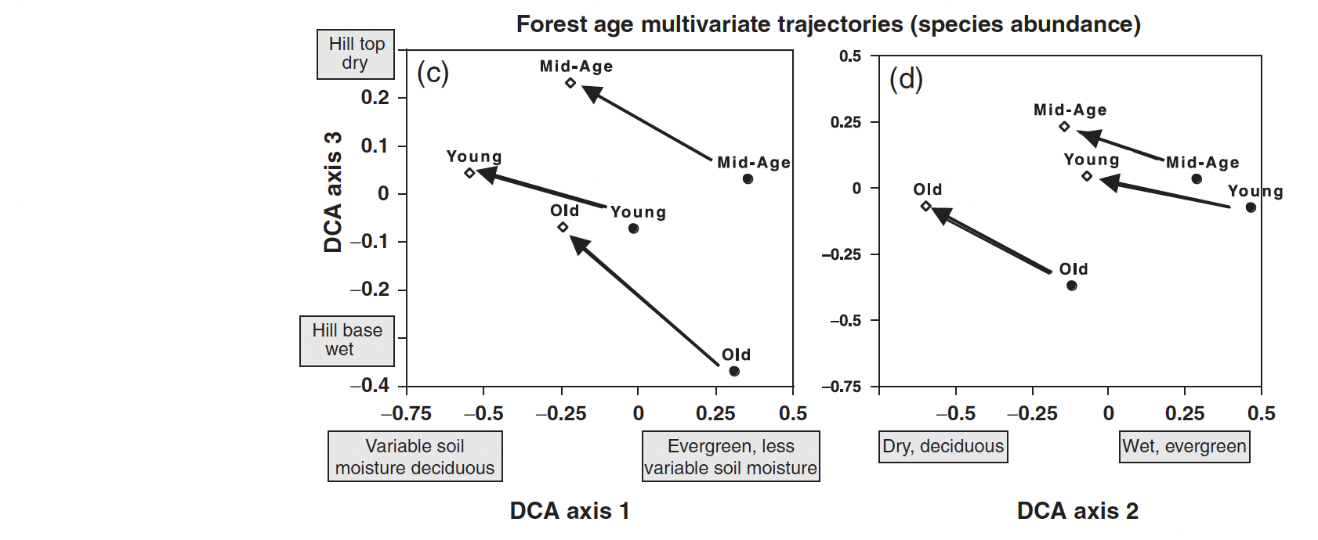
(2) Succession signal is present but minimal
Floristic shifts between 1976 and 1996
Enquist and Enquist (2011) Global Change Biology

Slide 36
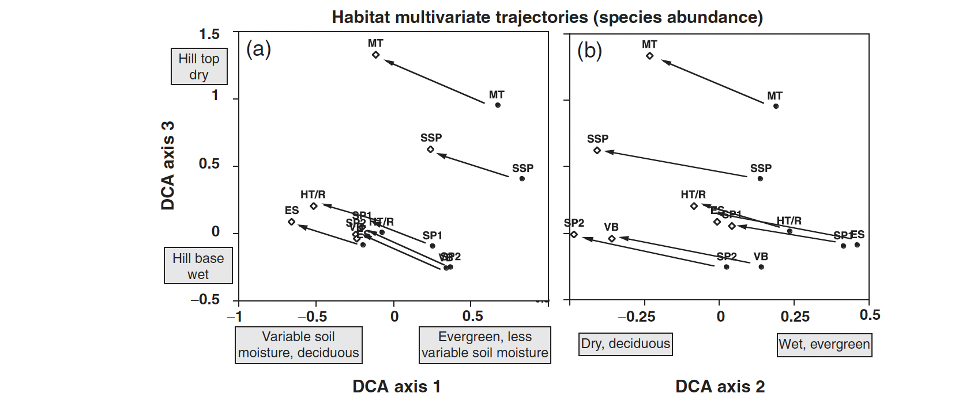
(3) Forest is turning more deciduous - Loss of evergreen mesic species
Enquist and Enquist (2011) Global Change Biology

Slide 37

Remote sensing metrics are consistent with this shift
Monitoring the San Emilio forest with Satellites (Landsat and Worlldview-2)
Characterize change in Deciduousness and Productivity
Dry Season 2011
Wet Season 2015
Wet Season 2015
Dry Season 2017
Wet Season 2017

Slide 38

Remote sensing metrics are consistent with this shift
Landsat time series
Canopy Deciduousness
Fraction of non photosynthetic vegetation
Proxy for forest productivity , EVI (Canopy Greeness)
El Niño
El Niño
Wet Season
Dry Season
Dry Season
Wet Season canopy greenness has been increasing
  deciduous trees have higher EVI or greenness values in wet season
Dry Season canopy deciduousness has been increasing
deciduous trees are becoming more prevalent)

Slide 39


(4) There is also a directional shift in forest phenotypes (Traits)
Consistent with succession* (maturation of forest)
Increases in mean height
Consistent with increased drought
Reductions in leaf area
Reductions in Specific Leaf Area (SLA)
Increases in wood density
Swenson et al. (2020) Ecological Monographs

Slide 40

Observed shift in the functional composition of this dry forest due to large changes in abundance for multiple species on the periphery of trait space.
Standardized effect size (SES) values for the mean nearest neighbor distance (MNND) in 20 x 20 m quadrats during each of the three censuses for individual traits and the individual PC axis 1 and 2 scores.
Negative values indicate lower than expected trait diversity, and positive values indicate higher than expected trait values
Functional shifts are not driven by a few anomalous population expansions or collapses
Swenson et al. (2020) Ecological Monographs

Slide 41



(5) Notable reduction in forest understory species and stems
Evergreen understory trees disproportionately dropping out
- Large reductions in Ocotea veraguensis LAURACEAE (left)
- Complete loss of understory Piper amalgo PIPERACEAE (right)
Enquist and Enquist (2011) Global Change Biology
April, 2008

Slide 42

45 Year Higher Order Stats
Number of Stems:
1976: 24,570 (DBH >= 3cm)
1996: 17,986
2006: 22,413
2020: 23,850 - (36,465, DBH >= 1cm)
Species Richness:
1976: 159 2006: 126
1996: 150 2020: 145
Chmurzynski et al. In Prep
DBH (cm)

Slide 43

Abundance change (2006 - 2020)
2006: 22,413
2020: 23,850
Although a total increase in stems…
Persistent evidence of mortality in lower size classes even in later surveys
Chmurzynski et al. In Prep

Slide 44
Conclusions - Why is this forest plot notable?
Tropical dry forest (seasonal drought, high interannual variation in rainfall)
A bellwether for the fate of more mesic tropical forests under climate change
One of a relatively small number of dry forest plots
Disturbed
It is in various stages of recovery from human disturbance
An accurate reflection of an increasing large fraction of tropical forest
Long-term dynamics
Although only 1 census with ForestGeo protocol, 3 additional surveys with overlapping protocols provide 44 years of forest dynamics.

Slide 45




Slide 46
Acknowledgements
Nathan Swenson, Adam Chmurzynski, Nelson Zamora, Roberto Espinoza, Roger Blanco, Alejandro Masis, Steve P. Hubbell, George C. Stevens
Catherine Hulshof, Cho-ying Huang, Carolyn A. F. Enquist, Sandra Duran, Lisa Patrick Bentley, Sean Michaletz, Arturo Sanchez-Azofeifa
Field Crews
Support
Funding and Institutional Support
Adrian Solis-Vargas
Gustavo Delgado
Qing He
Hsin-Ju Li
Damani Eubanks
Matiss Castorena
Maria-Fernanda
Obando-Picado
Milagro Jimenez
Josue Pacheco
Dan Janzen
Winnie Hallwachs
Maria Chavaria
Jon Sullivan
Camillo Camargo
Lisa Rose
Tom Gillispie
R. Franco
J. Klemens
National Science Foundation
Fulbright Fellowship(s)
Nature Conservancy
Tinker Foundation
National Geographic
ForestGEO
ACG, Costa Rica
Instituto Nacional de Biodiversidad (INBIO)
National Herbarium of Costa Rica

